Slide 1
Daily Tasks
Eric Vara

Slide 2

Agenda
Morning
Exercise
Schedule
Work
Lunch
Career
School
Family
Dinner
Plan Next Day

Slide 3
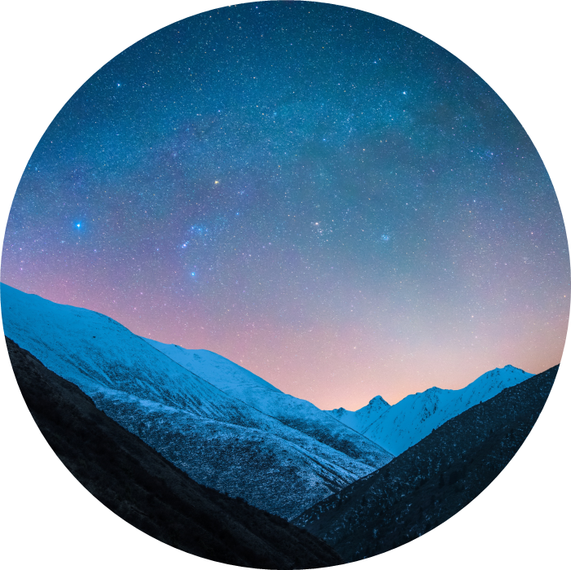
Introduction
I live a balanced and intentional life, focusing on my physical well-being through healthy meals, exercise, and staying hydrated. I use Google Calendars to plan my day, ensuring my tasks align with my goals and allowing time for personal and professional development. I make mindful choices for meals, learn and complete assignments, and strengthen family bonds. Wrapping up the day with a nutritious dinner and reviewing my schedule, I aim for fulfillment and purpose in everything I do.

Slide 4
Morning
Breakfast
Water
Breakfast Burritos
Eggs, Bacon, Potato’s
Orange Juice
Vitamins
Goals: +25g Protein, +25g Fats, +50g Carbs
Kids off to School

Slide 5
Exercise
Drink Water
Take Vitamins
Ready Gym bag
Take pre-workout nutrition shake
Drive to gym
Warmup
Exercises for the day
Stretch
Sauna and cold plunge
Take post-workout nutrition shake

Slide 6
Schedule
Drink Water
Check daily schedule
Check to-do lists
Check Email
Daily Tasks Realign with Future Goals (Google Calendars)

Slide 7
Work
Drink Water
Study Scope of Work
Research Solutions
Propose Solution
Revise Solution
Execute Solution
Present Solution

Slide 8
Lunch
Options:
Water
Breakfast Burritos
Eggs, Bacon, Potato’s
Orange Juice
Vitamins
Goals: +25g Protein, +25g Fats, +50g Carbs

Slide 9
Career
Drink Water
Projects:
Study new techniques
Work on up-skilling towards industry demands
Work on side hustle ideas
Think and process through Journal Ideas
To-do:
Work on Certifications
Network on social Media
Attend meetup group/community meetups

Slide 10
School
Drink Water
One Item Each Day:
Read 1 Chapter
Complete 1 Assignment

Slide 11
Family
Drink Water
Options:
Drink Water
Weekend trip
Kids Activities
Vacation Planning
New Quality Idea

Slide 12
Dinner
Drink Water
Options:
Drink Water
Weekend cheat meal
Cook new meal with spouse
New Quality Idea
Goals: +25g Protein, +25g Fats, +50g Carbs

Slide 13
Plan Next Day
Check daily schedule
Check to-do lists
Check Email
Daily Tasks Realign with Future Goals (Google Calendars)

Slide 14
Chart

Slide 15




Thank you
Eric Vara

